Slide 1
Local features (Szeliski 4.1)
Michael S. Ryoo

Slide 2

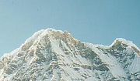
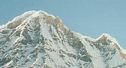
Local features: main components
Detection: Identify the interest points
Description: Extract vector feature descriptor surrounding each interest point.
Matching: Determine correspondence between descriptors in two views
Kristen Grauman

Slide 3
Local features: desired properties
Repeatability
The same feature can be found in several images despite geometric and photometric transformations
Saliency
Each feature has a distinctive description
Compactness and efficiency
Many fewer features than image pixels
Locality
A feature occupies a relatively small area of the image; robust to clutter and occlusion

Slide 4
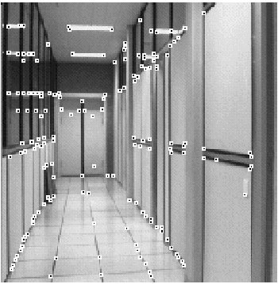
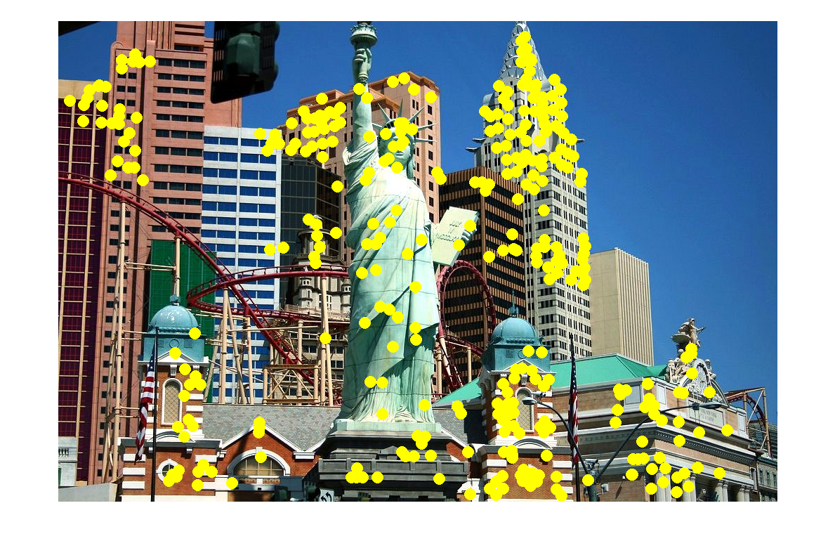
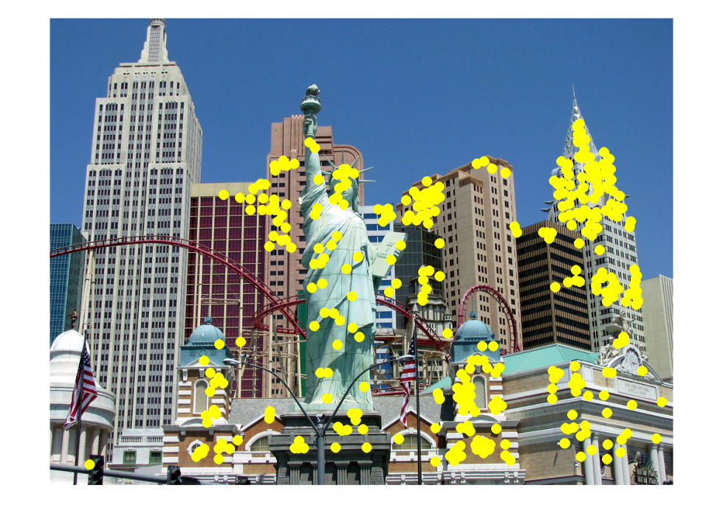
Applications
Local features are used for:
Image alignment
3D reconstruction
Motion tracking
Robot navigation
Indexing and database retrieval
Object recognition
Lana Lazebnik

Slide 5
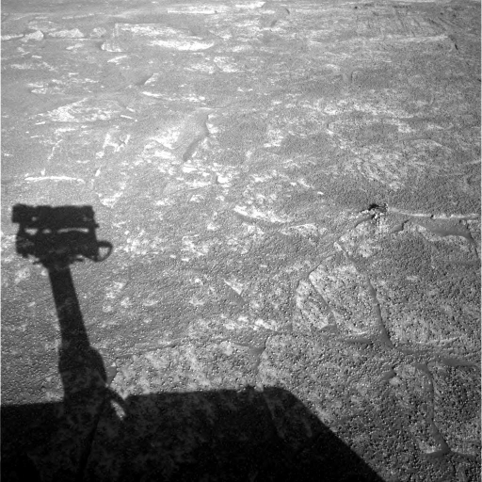
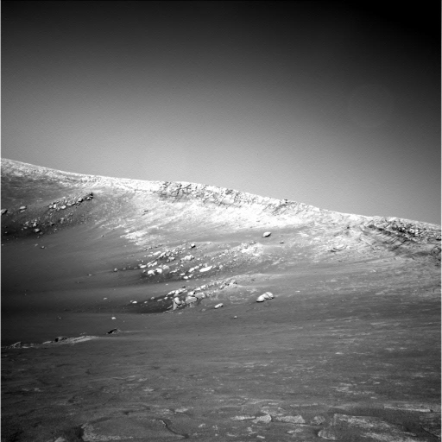
A hard feature matching problem
NASA Mars Rover images

Slide 6
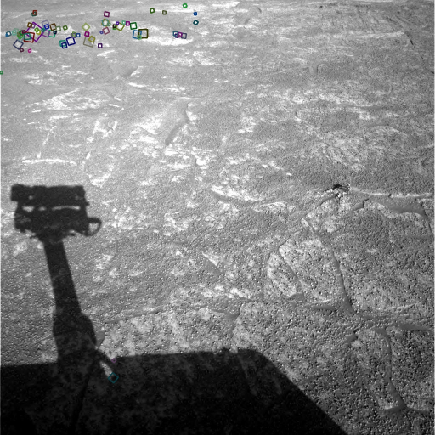
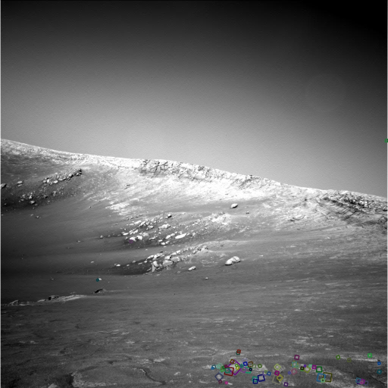
Answer below (look for tiny colored squares…)
NASA Mars Rover images
with SIFT feature matches Figure by Noah Snavely

Slide 7
Goal: interest operator repeatability
We want to detect (at least some of) the same points in both images.
Yet we have to be able to run the detection procedure independently per image.
No chance to find true matches!
Notes:
7

Slide 8
Goal: descriptor distinctiveness
We want to be able to reliably determine which point goes with which.
Must provide some invariance to geometric and photometric differences between the two views.
?

Slide 9
Local features: main components
Detection: Identify the interest points
Description:Extract vector feature descriptor surrounding each interest point.
Matching: Determine correspondence between descriptors in two views

Slide 10
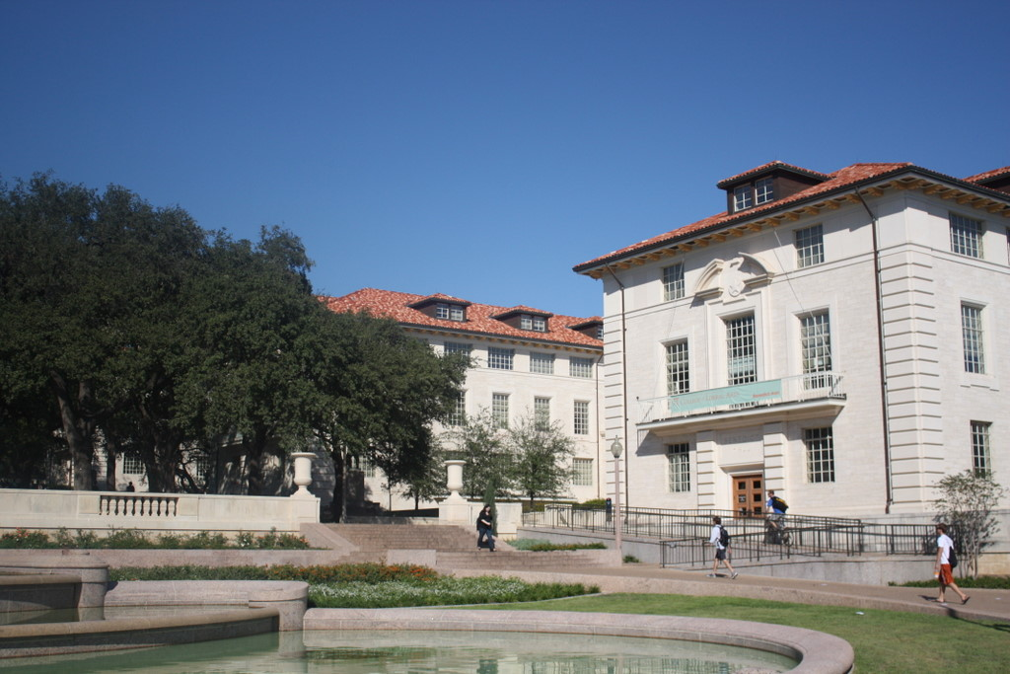
What points would you choose?

Slide 11

Corners as distinctive interest points
We should easily recognize the point by looking through a small window
Shifting a window in any direction should give a large change in intensity
“flat” region: no change in all directions
“edge”: no change along the edge direction
“corner”: significant change in all directions
Slide credit: Alyosha Efros, Darya Frolova, Denis Simakov

Slide 12
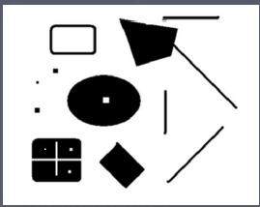
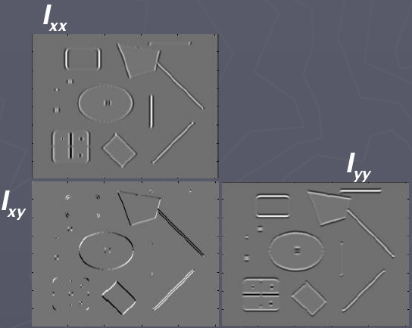
Corners as distinctive interest points
2 x 2 matrix of image derivatives (averaged in neighborhood of a point).
Notation:

Slide 13
What does this matrix reveal?
First, consider an axis-aligned corner:

Slide 14
What does this matrix reveal?
First, consider an axis-aligned corner:
This means dominant gradient directions align with x or y axis
Look for locations where both λ’s are large.
If either λ is close to 0, then this is not corner-like.
What if we have a corner that is not aligned with the image axes?

Slide 15
What does this matrix reveal?
Since M is symmetric, we have
(Eigenvalue decomposition)
The eigenvalues of M reveal the amount of intensity change in the two principal orthogonal gradient directions in the window.

Slide 16
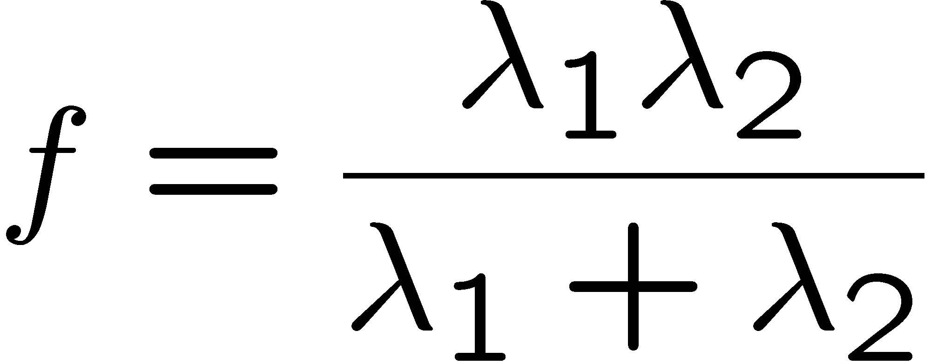
Corner response function
“edge”:
“corner”:
“flat” region
λ₁ >> λ₂
λ₁ and λ₂ are large, λ₁ ~ λ₂;
λ₁ and λ₂ are small;
λ₂ >> λ₁

Slide 17
Harris corner detector
Compute M matrix for each image window to get their cornerness scores.
Find points whose surrounding window gave large corner response (f > threshold)
Take the points of local maxima, i.e., perform non-maximum suppression
Notes:
17

Slide 18

Harris Detector: Steps
Kristen Grauman

Slide 19

Harris Detector: Steps
Compute corner response f
Kristen Grauman

Slide 20

Harris Detector: Steps
Find points with large corner response: f > threshold
Kristen Grauman

Slide 21
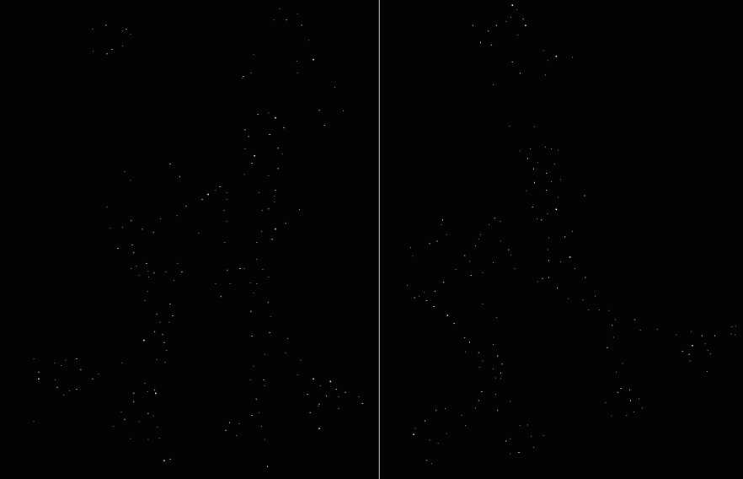
Harris Detector: Steps
Take only the points of local maxima of f
Kristen Grauman

Slide 22

Harris Detector: Steps
Kristen Grauman

Slide 23
Example of Harris application
Kristen Grauman

Slide 24
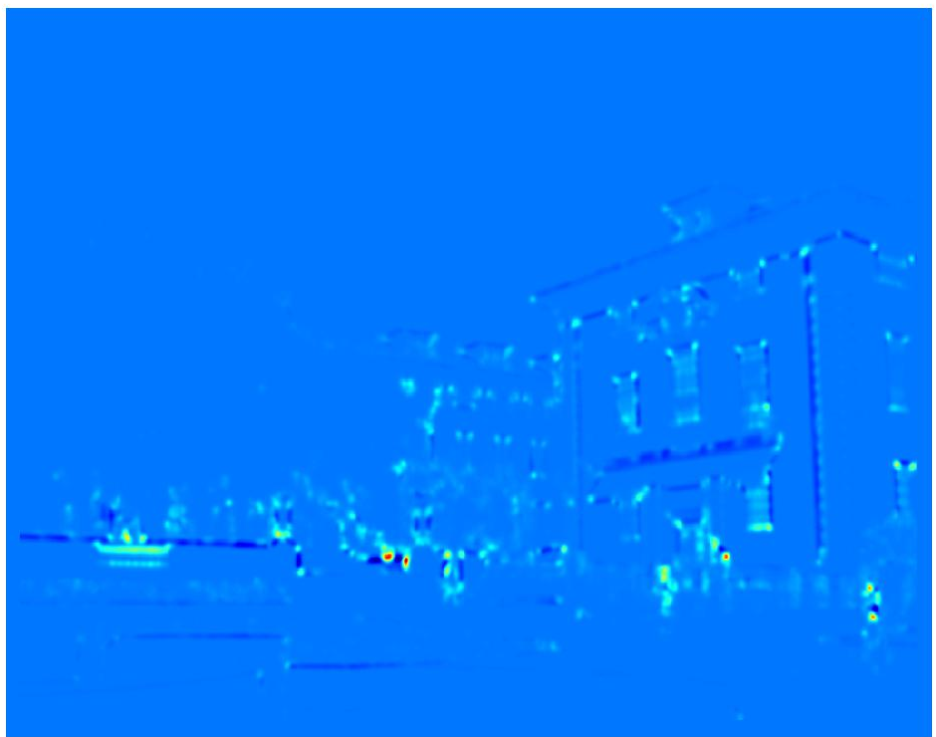
Example of Harris application
Compute corner response at every pixel.
Kristen Grauman

Slide 25
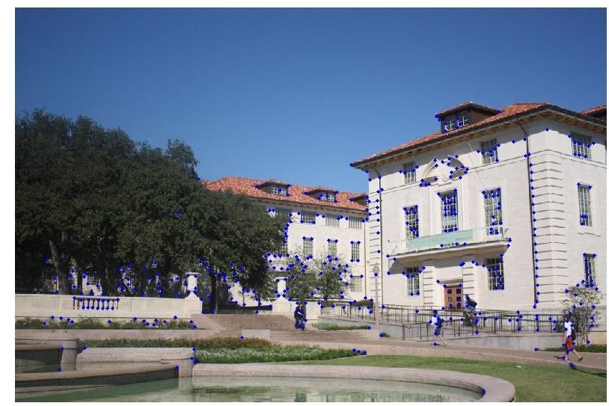
Example of Harris application
Kristen Grauman
Notes:
Only non-maxes exceeding average (thresholded)

Slide 26
Properties of the Harris corner detector
Rotation invariant?
Yes

Slide 27
Properties of the Harris corner detector
Rotation invariant?
Translation invariant?
Yes
Yes

Slide 28
Properties of the Harris corner detector
Rotation invariant?
Translation invariant?
Scale invariant?
Yes
Yes
No
All points will be classified as edges
Corner !

Slide 29
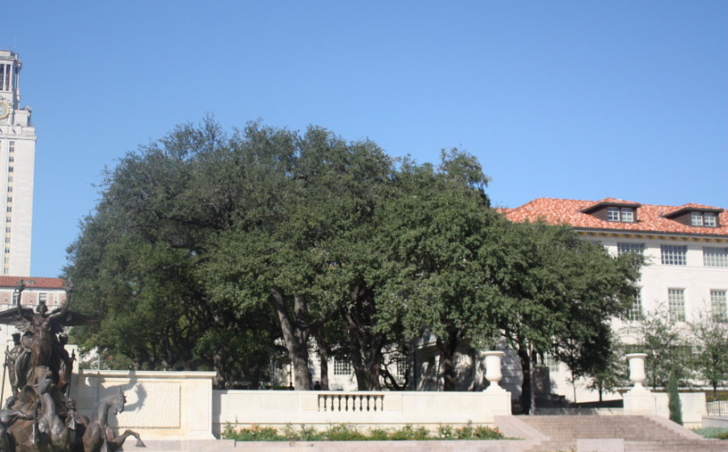
Scale invariant interest points
How can we independently select interest points in each image, such that the detections are repeatable across different scales?
Kristen Grauman

Slide 30
Automatic scale selection
Intuition:
Find scale that gives local maxima of some function f in both position and scale.
f
f
Image 1
Image 2
s₁
region size
s₂
region size
Slide credit: Kristen Grauman

Slide 31
What can be the “signature” function?
Kristen Grauman

Slide 32
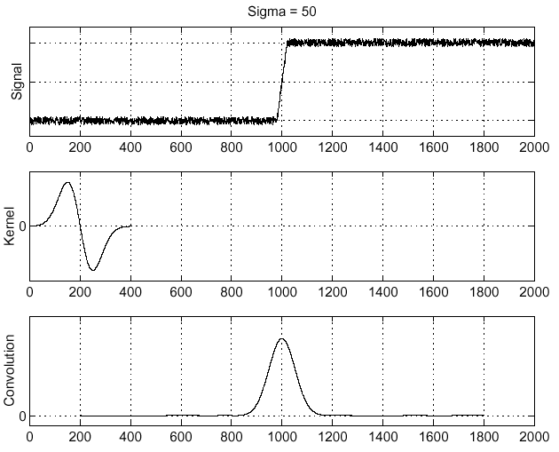
Recall: Edge detection
Edge
f
Derivative of Gaussian
Edge = maximum of derivative
Source: S. Seitz

Slide 33
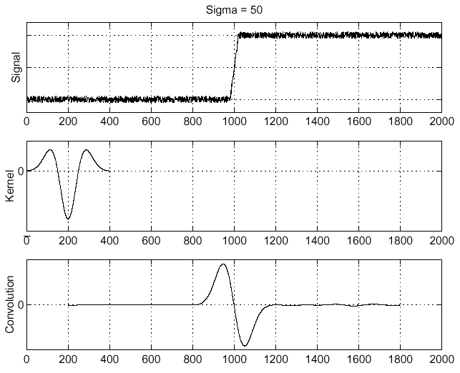
Recall: Edge detection
f
Edge
Second derivative of Gaussian (Laplacian)
Edge = zero crossing of second derivative
Source: S. Seitz

Slide 34
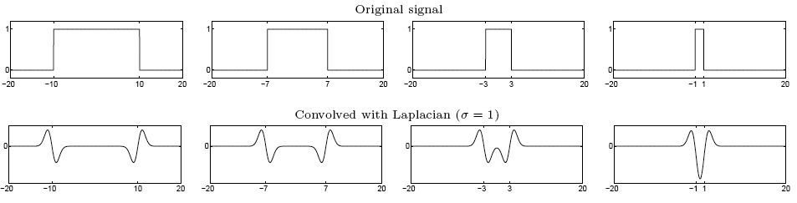
From edges to blobs
Edge = ripple
Blob = superposition of two ripples
maximum
Spatial selection: the magnitude of the Laplacian response will achieve a maximum at the center of the blob, provided the scale of the Laplacian is “matched” to the scale of the blob
Slide credit: Lana Lazebnik

Slide 35
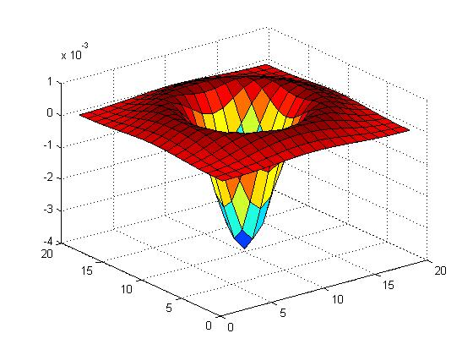

Blob detection in 2D
Laplacian of Gaussian: Circularly symmetric operator for blob detection in 2D

Slide 36
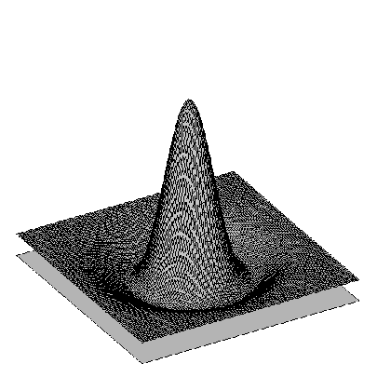

Blob detection in 2D: scale selection
Laplacian-of-Gaussian = “blob” detector
filter scales
img2
Bastian Leibe
img1
img3

Slide 37
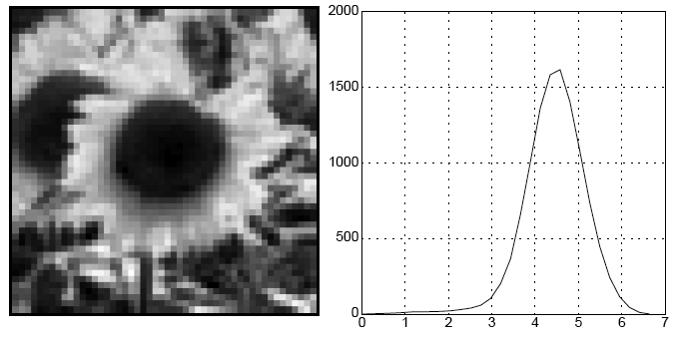
Blob detection in 2D
We define the characteristic scale as the scale that produces peak of Laplacian response
characteristic scale
Slide credit: Lana Lazebnik

Slide 38
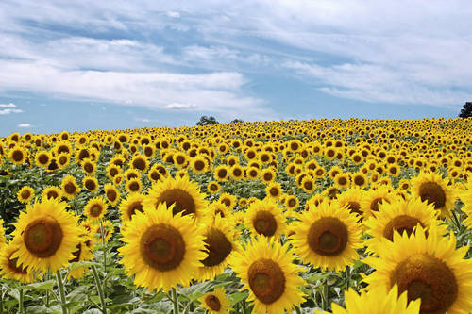
Example
Kristen Grauman

Slide 39
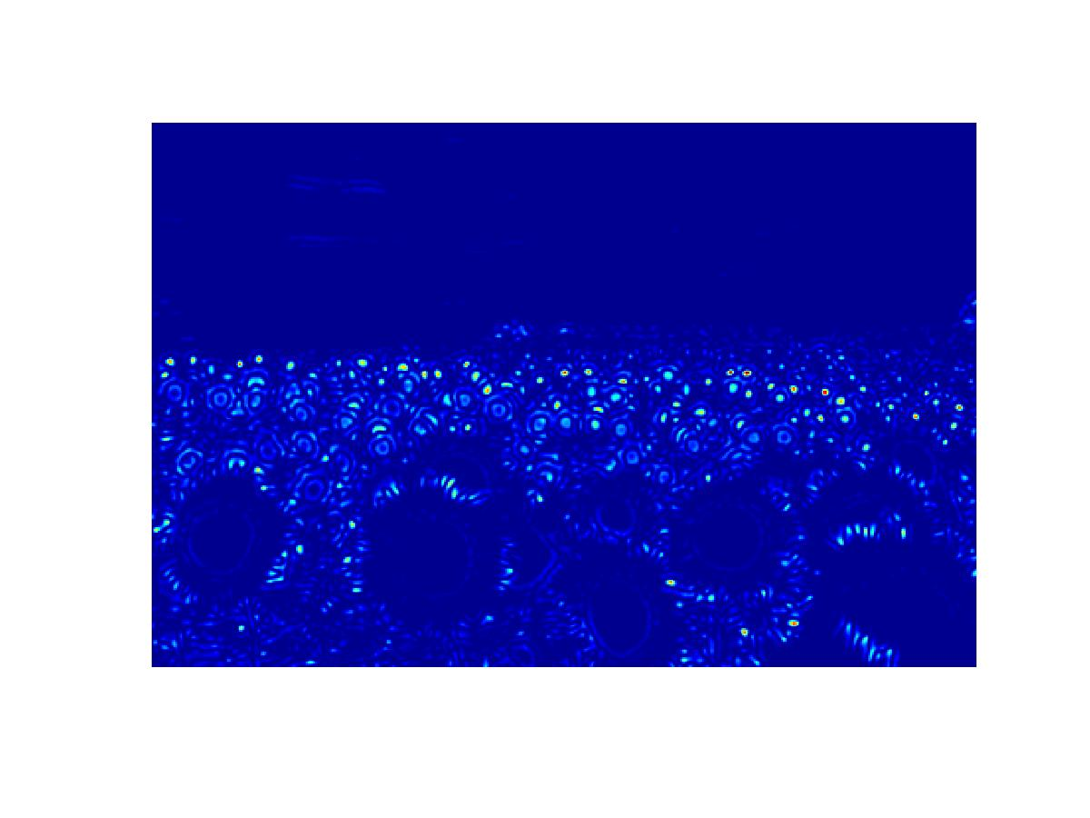
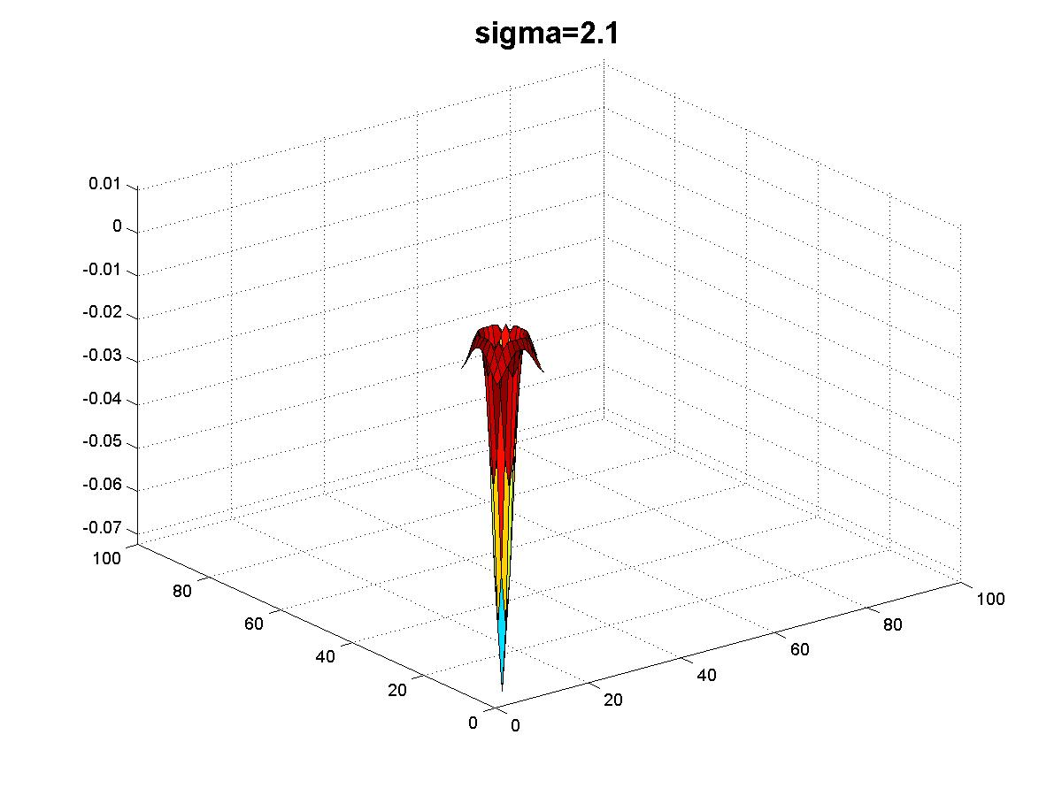
Kristen Grauman

Slide 40
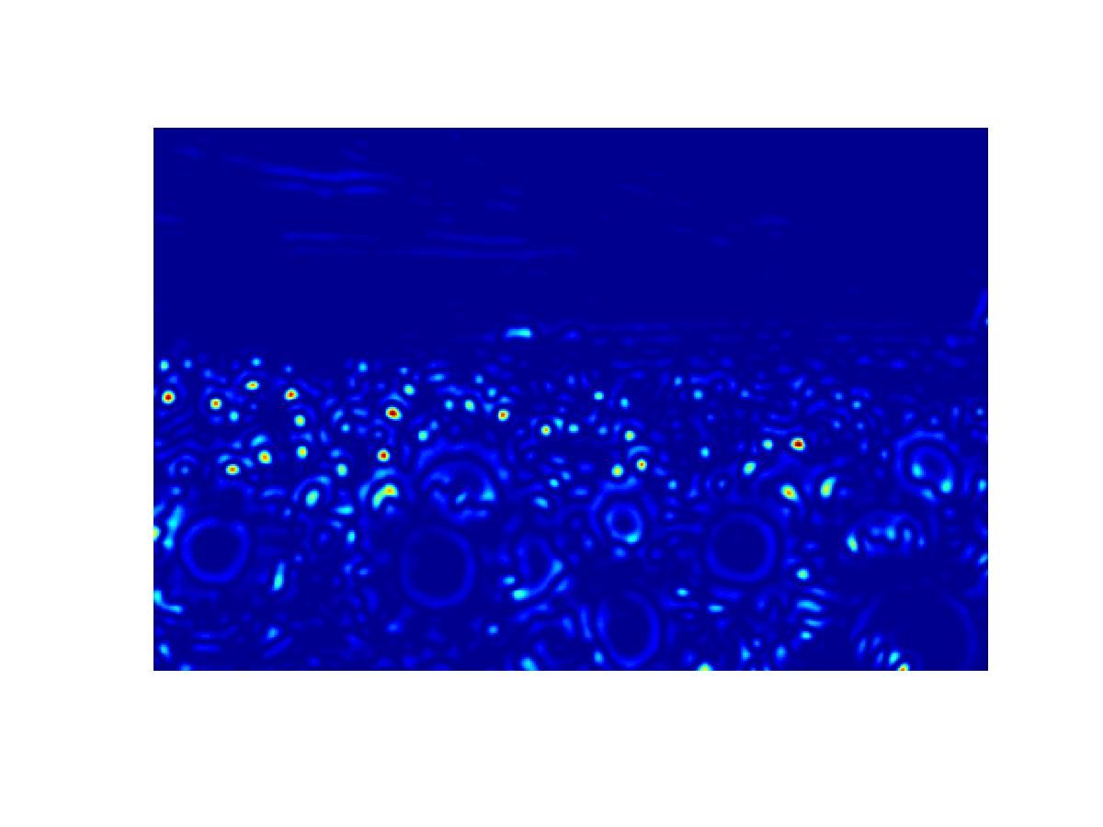
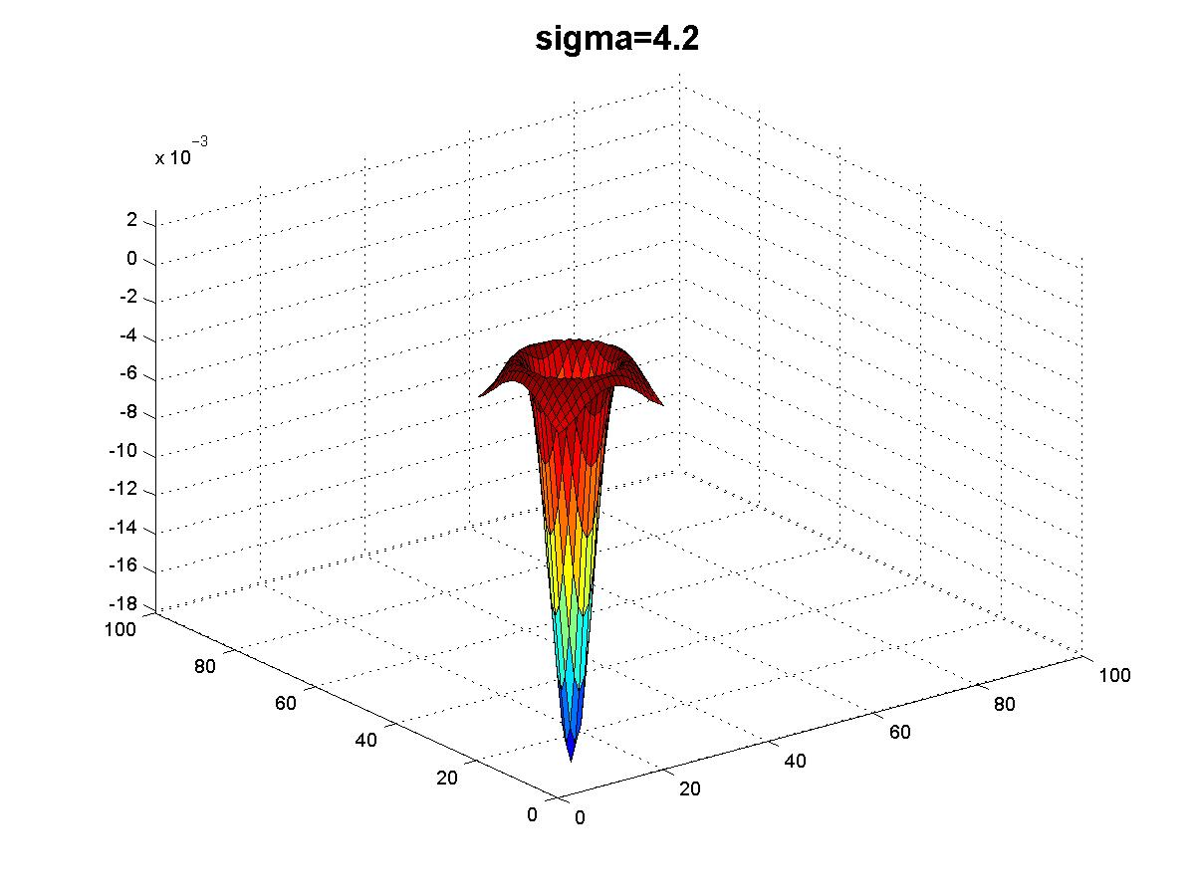
Kristen Grauman

Slide 41
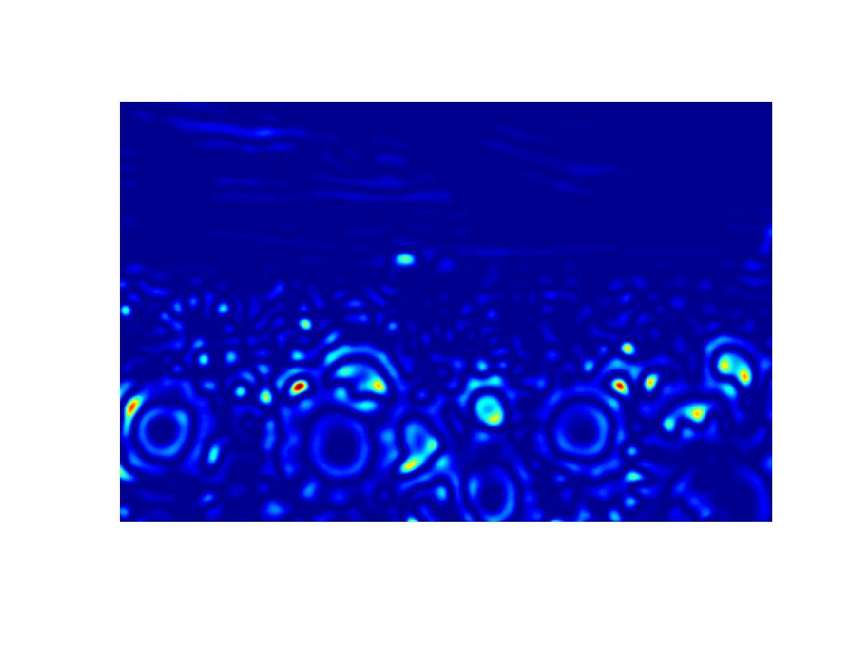
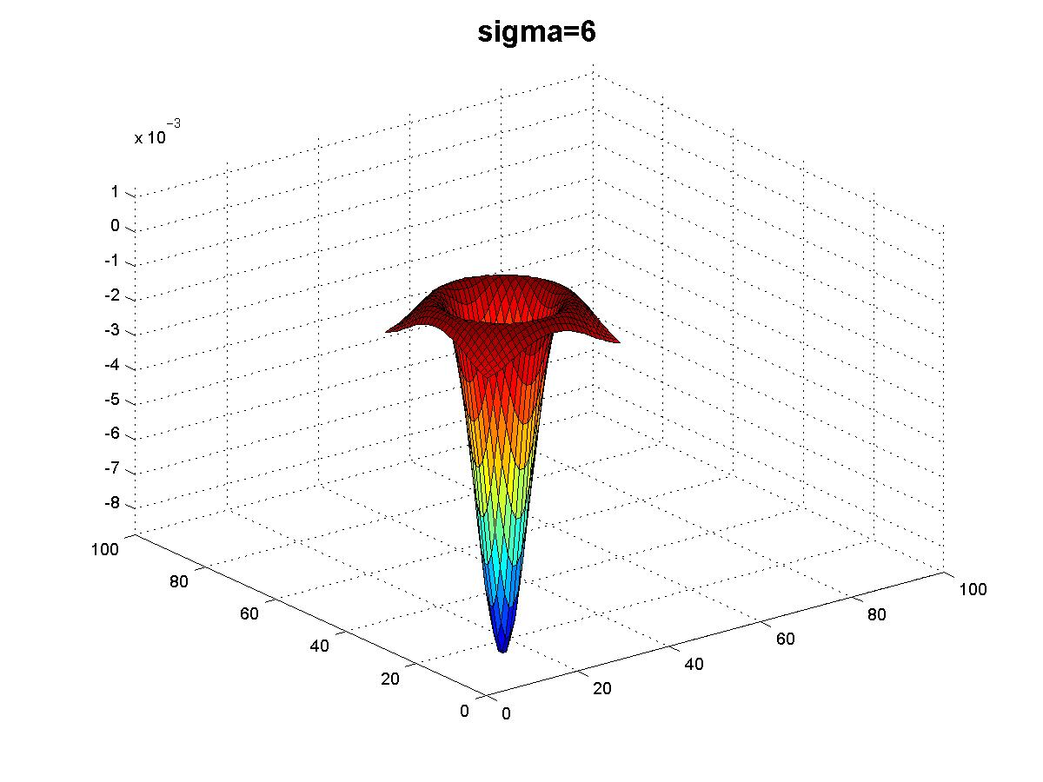
Kristen Grauman

Slide 42
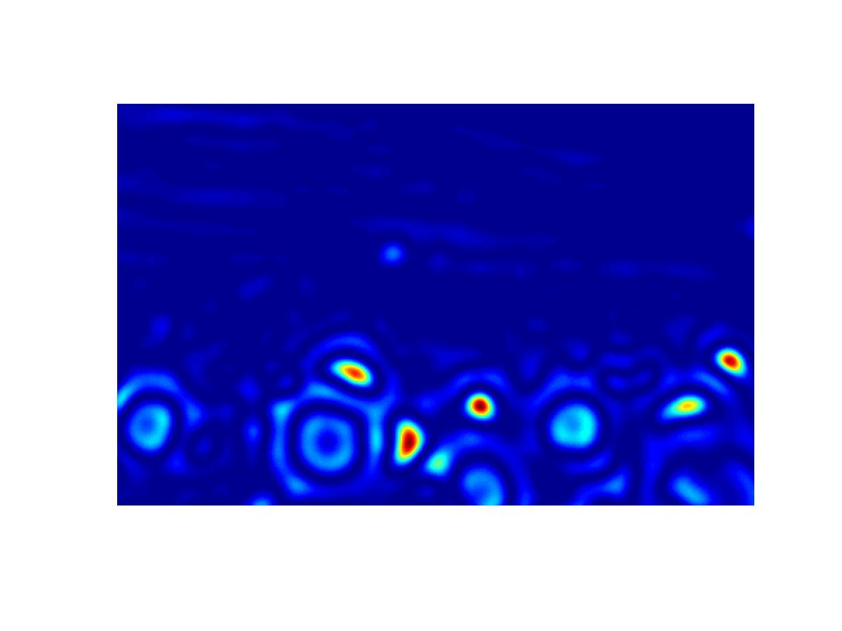
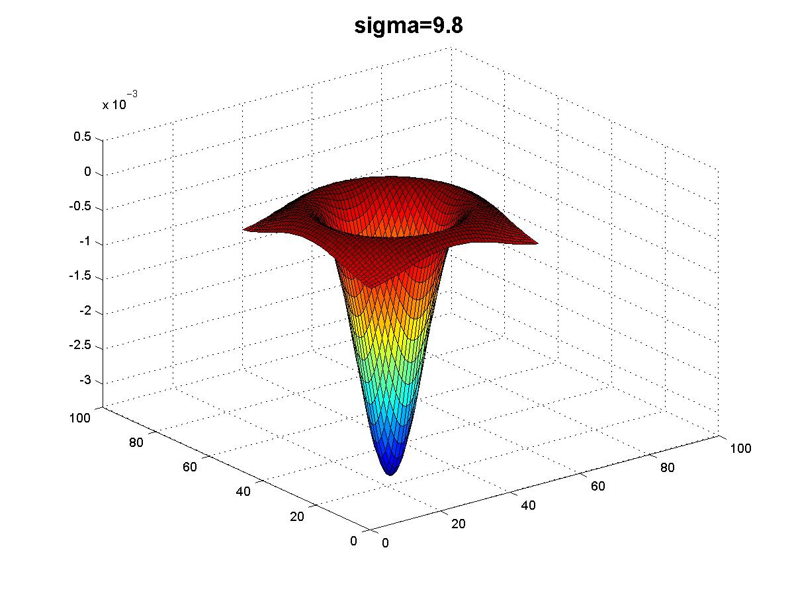
Kristen Grauman

Slide 43
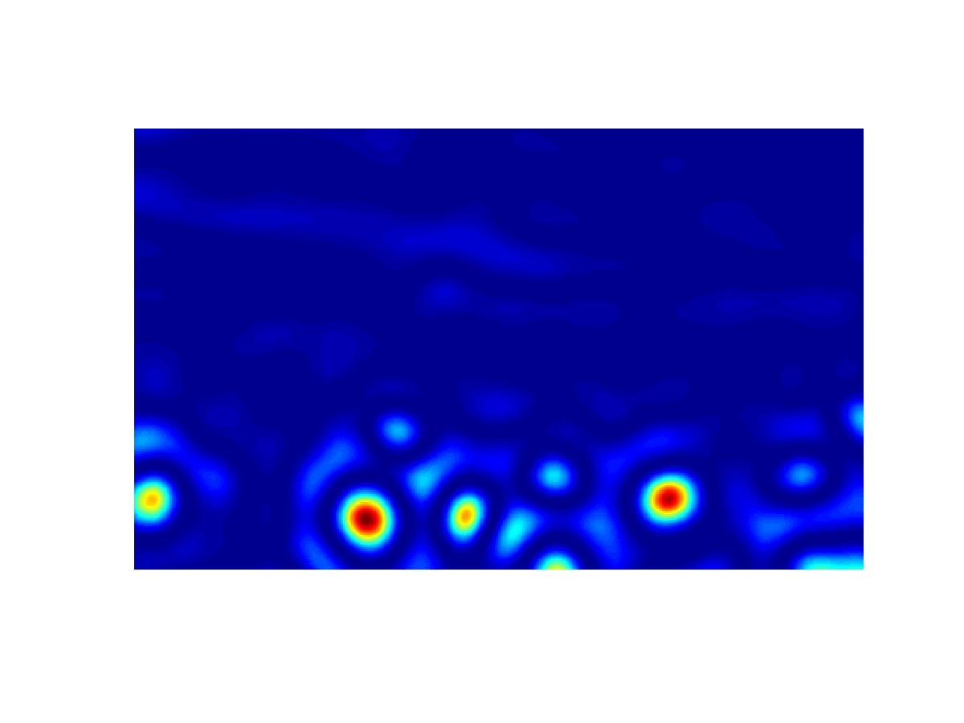
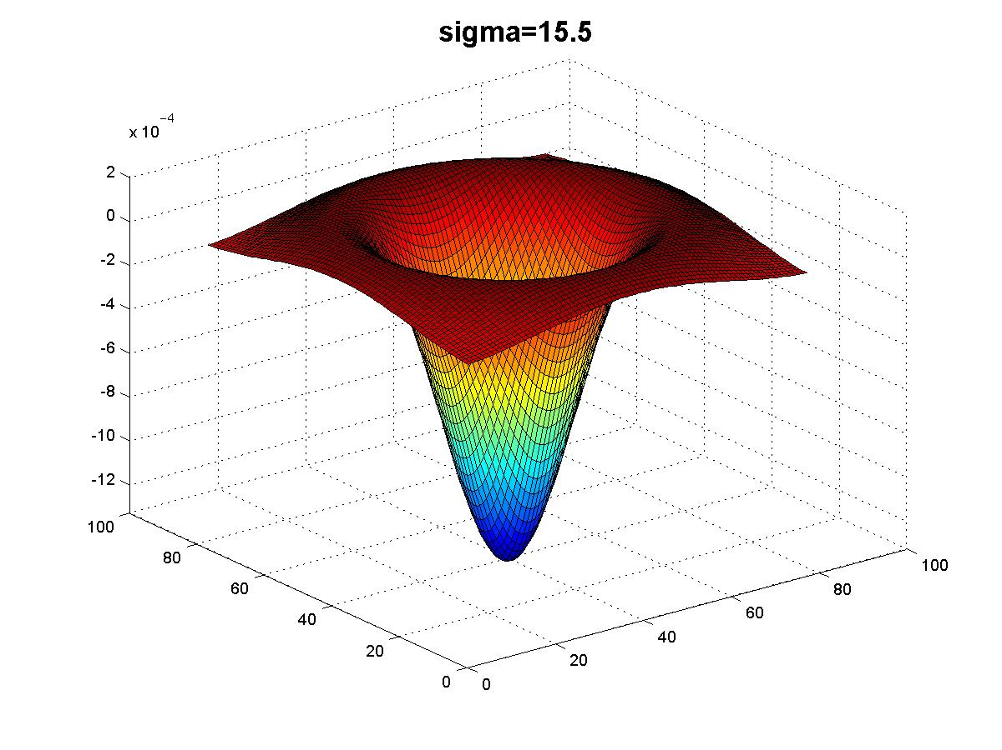
Kristen Grauman

Slide 44
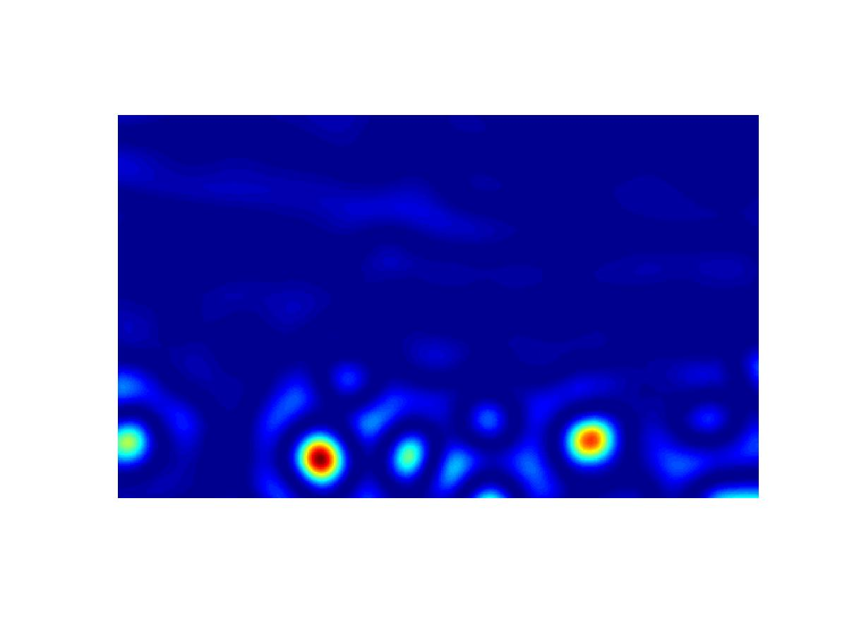
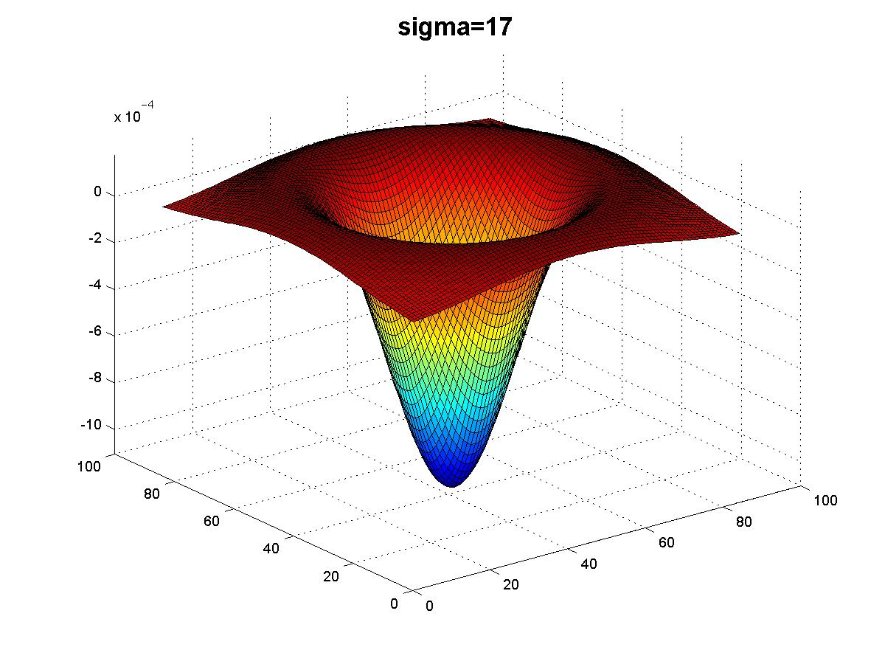
Kristen Grauman

Slide 45
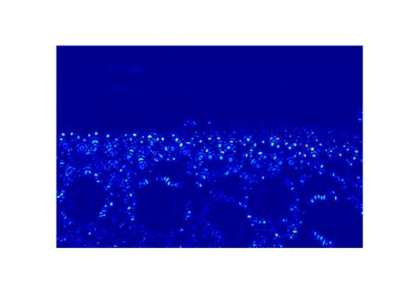
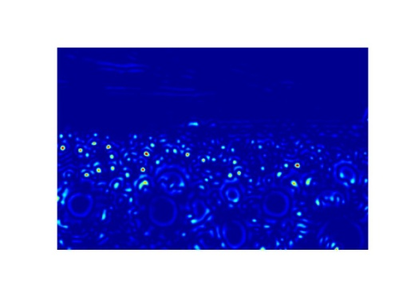
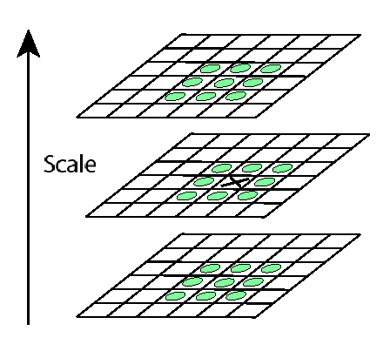
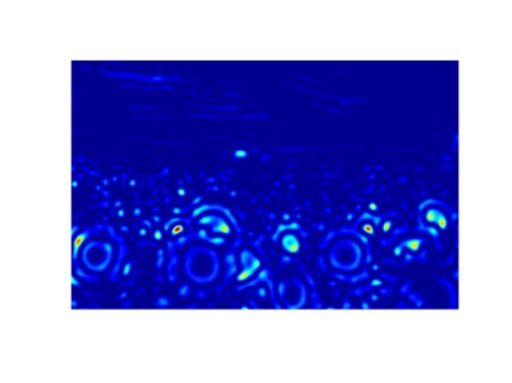
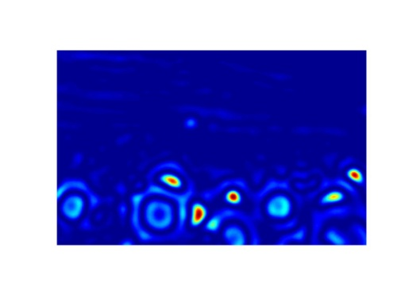

Scale invariant interest points
Interest points are local maxima in both position and scale.
σ5
σ4
scale
σ3
σ2
⇒ List of (x, y, σ)
σ1
Squared filter response maps
Kristen Grauman

Slide 46
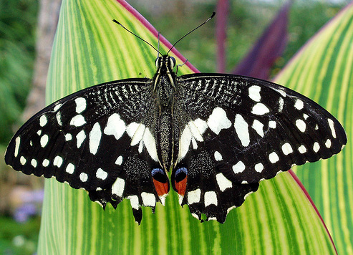
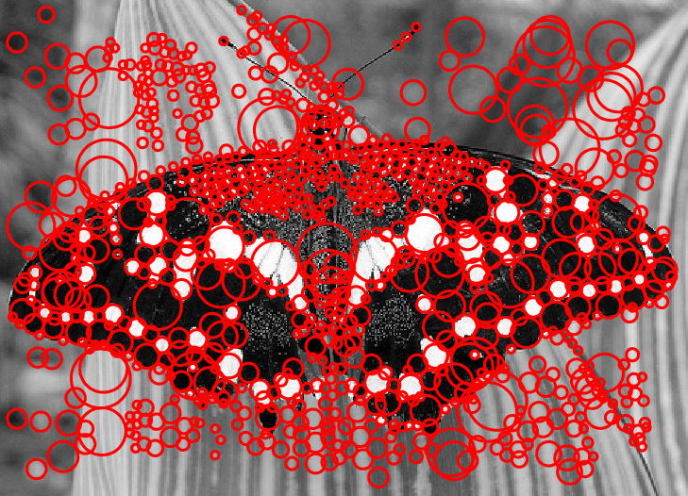
Scale-space blob detector: Example
Image credit: Lana Lazebnik

Slide 47
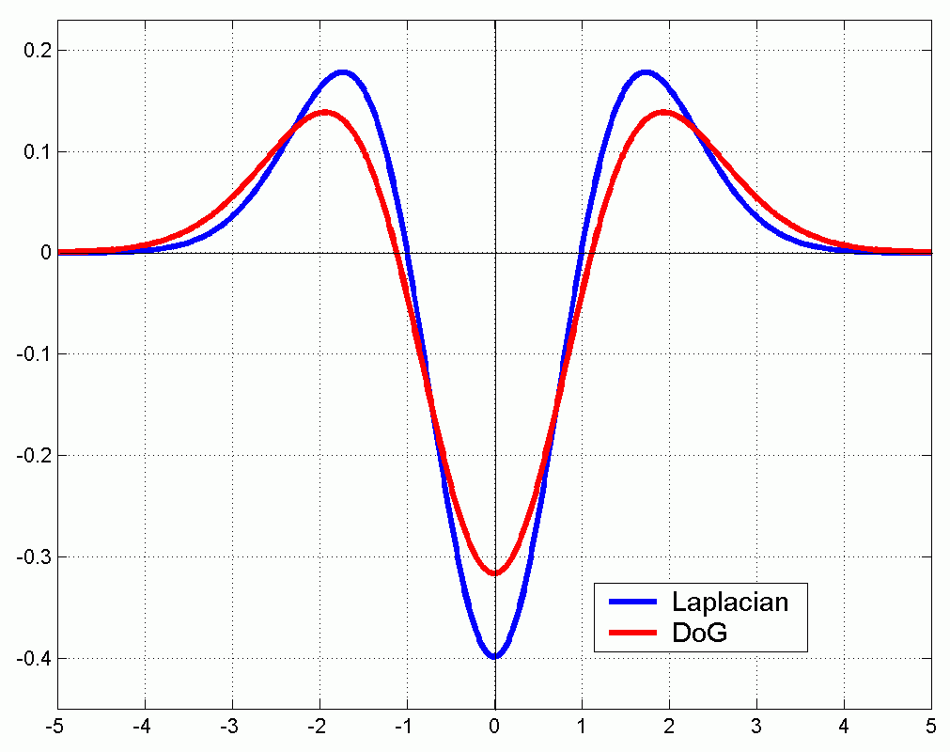
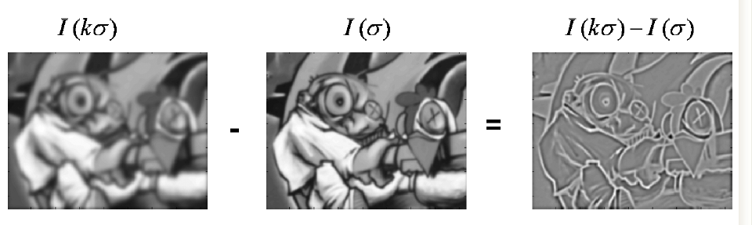
Technical detail
We can approximate the Laplacian with a difference of Gaussians; more efficient to implement.
(Laplacian)
(Difference of Gaussians)
Slide credit: Kristen Grauman

Slide 48
Local features: main components
Detection: Identify the interest points
Description: Extract vector feature descriptor surrounding each interest point.
Matching: Determine correspondence between descriptors in two views
Slide credit: Kristen Grauman

Slide 49




Geometric transformations
e.g. scale, translation, rotation
Slide credit: Kristen Grauman

Slide 50
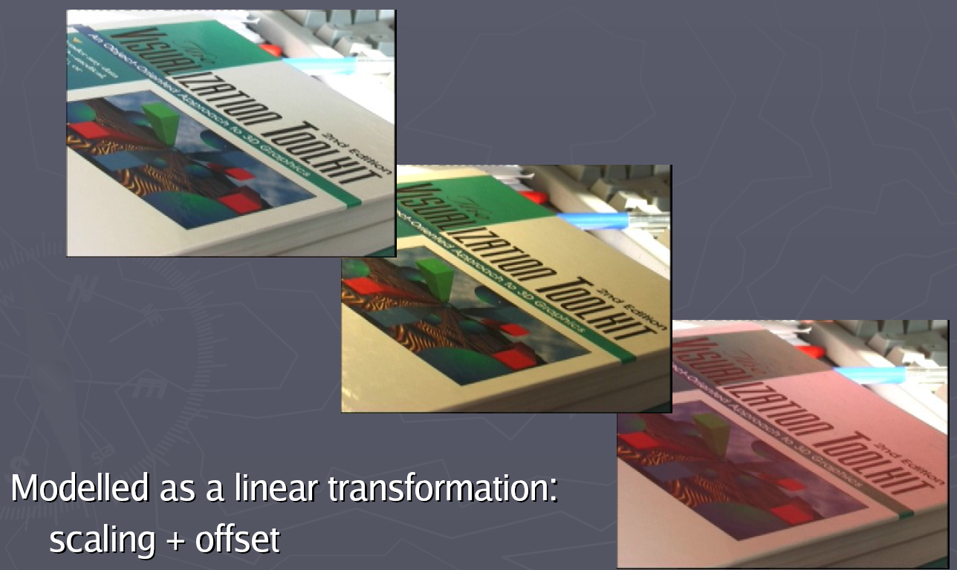
Photometric transformations
Figure from T. Tuytelaars ECCV 2006 tutorial

Slide 51
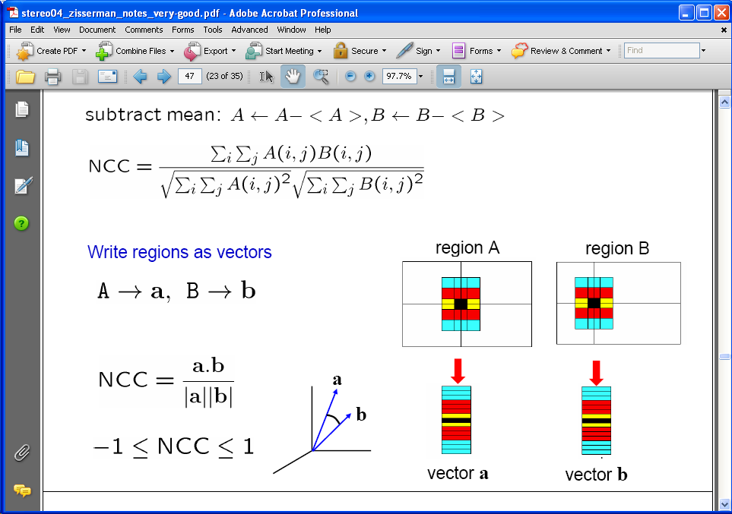
Raw patches as local descriptors
The simplest way to describe the neighborhood around an interest point is to write down the list of intensities to form a feature vector.
But this is very sensitive to even small shifts, rotations.
Slide credit: Kristen Grauman

Slide 52

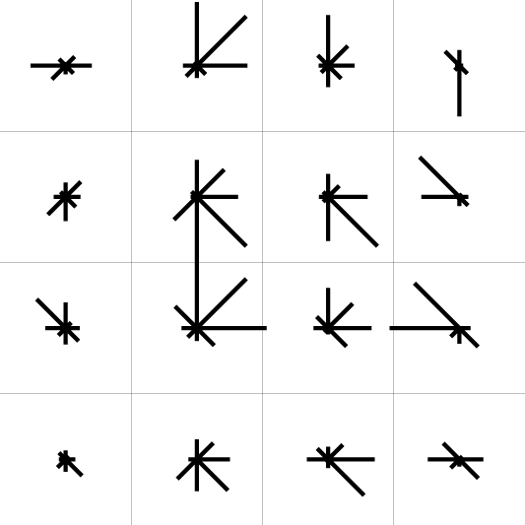
SIFT descriptor [Lowe 2004]
Use histograms to bin pixels within sub-patches according to their orientation.
0
2
π
Why subpatches?
Why does SIFT have some illumination invariance?
Slide credit: Kristen Grauman

Slide 53
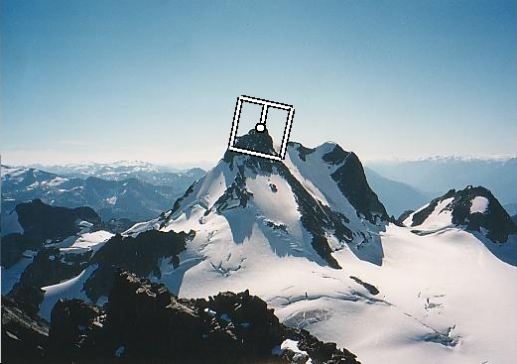
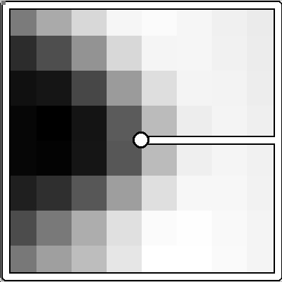
Making descriptor rotation invariant
CSE 576: Computer Vision
Rotate patch according to its dominant gradient orientation
This puts the patches into a canonical orientation.
Image from Matthew Brown

Slide 54


SIFT descriptor [Lowe 2004]
Extraordinarily robust matching technique
Can handle changes in viewpoint
Up to about 60 degree out of plane rotation
Can handle significant changes in illumination
Sometimes even day vs. night (below)
Fast and efficient—can run in real time
Lots of code available
http://people.csail.mit.edu/albert/ladypack/wiki/index.php/Known_implementations_of_SIFT
54
Steve Seitz

Slide 55
Example
NASA Mars Rover images

Slide 56
Example
NASA Mars Rover images
with SIFT feature matches Figure by Noah Snavely

Slide 57
SIFT descriptor properties
Invariant to
Scale
Rotation
Partially invariant to
Illumination changes
Camera viewpoint
Occlusion, clutter
Slide credit: Kristen Grauman

Slide 58
Local features: main components
Detection: Identify the interest points
Description:Extract vector feature descriptor surrounding each interest point.
Matching: Determine correspondence between descriptors in two views
Slide credit: Kristen Grauman

Slide 59


Matching local features
Kristen Grauman

Slide 60


Matching local features
?
Image 1
Image 2
To generate candidate matches, find patches that have the most similar appearance (e.g., lowest SSD)
Simplest approach: compare them all, take the closest (or closest k, or within a thresholded distance)
Kristen Grauman

Slide 61
Ambiguous matches
?
?
?
?
Image 1
Image 2
To add robustness to matching, can consider ratio: distance to best match / distance to second best match
If low, first match looks good.
If high, could be ambiguous match.
Kristen Grauman

Slide 62

Matching SIFT Descriptors
Nearest neighbor (Euclidean distance)
Threshold ratio of nearest to 2nd nearest descriptor
Lowe IJCV 2004

Slide 63
Applications of local invariant features
Wide baseline stereo
Motion tracking
Panoramas
Mobile robot navigation
3D reconstruction
Recognition
…
Slide credit: Kristen Grauman

Slide 64



Automatic mosaicing
http://www.cs.ubc.ca/~mbrown/autostitch/autostitch.html
Slide credit: Kristen Grauman
Notes:
AutoStitch works from unordered collections of images, automatically finding matches between images using SIFT. It then robustly aligns all images and uses advanced blending algorithms to form seamless panoramas.

Slide 65

Robust feature-based alignment
Extract features
Compute putative matches
Loop:
Hypothesize transformation T (small group of putative matches that are related by T)
Verify transformation (search for other matches consistent with T)
Source: L. Lazebnik

Slide 66

Robust feature-based alignment
Extract features
Compute putative matches
Loop:
Hypothesize transformation T (small group of putative matches that are related by T)
Verify transformation (search for other matches consistent with T)
Source: L. Lazebnik

Slide 67

Wide baseline stereo
[Image from T. Tuytelaars ECCV 2006 tutorial]

Slide 68




Recognition of specific objects, scenes
Schmid and Mohr 1997
Sivic and Zisserman, 2003
Rothganger et al. 2003
Lowe 2002
Kristen Grauman

Slide 69
Summary
Interest point detection
Harris corner detector
Laplacian of Gaussian, automatic scale selection
Invariant descriptors
Rotation according to dominant gradient direction
Histograms for robustness to small shifts and translations (SIFT descriptor)

